Slide 1
Group 1
Final Visuals
Human Resources Dataset
CSC302
April 18, 2023
Roderick Payne
Matthew Jackson
Kati Johnson

Slide 2
TABLE OF CONTENTS
01
ABOUT THE DATASET
02
PREDICTION & CODE
03
VISUALS & CONCLUSION
04
LESSONS LEARNED

Slide 3
ABOUT THE DATA
Human Resource Employee Data Set
Sources
The dataset contains fictional data created by IBM data scientists, meant to mimic Human Resources data on employees from IBM, including current and former employees.
The dataset includes 33 data points (or columns), which includes variables like Gender, Age, Education, Department, Years Since Last Promotion, Hourly Pay Rate, and more.
The original dataset was in Spanish so we used a translated dataset.
English Language Data: https://www.kaggle.com/datasets/rishikeshkonapure/hr-analytics-prediction
Spanish Language Data: https://www.kaggle.com/datasets/pavansubhasht/ibm-hr-analytics-attrition-dataset

Slide 4
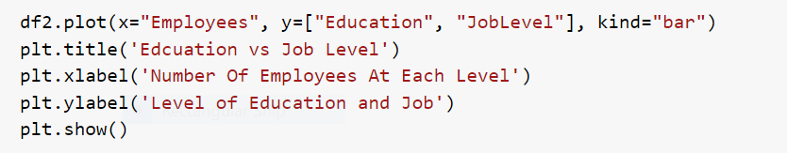
V1
CODE
How does Education Correlate with Job Level
Prediction: Higher Education holds a Higher level of job
Python Column Chart

Slide 5
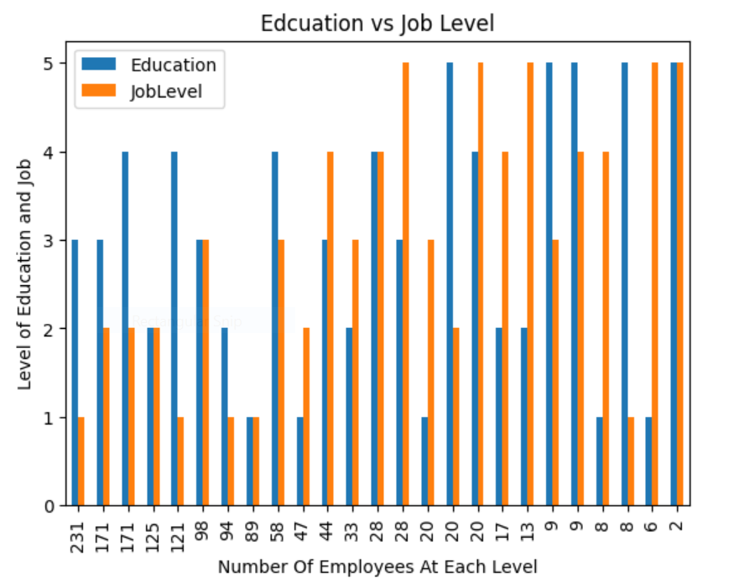
How does Education Correlate with Job Level
Conclusion: The data in the chart proves higher education does always hold a higher level position.
V1
Python Column Chart

Slide 6
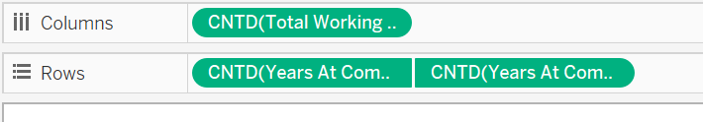
V2
CODE
How many total years worked vs. Year worked at the company
Prediction: Total years worked will more than years worked at the company
Connected Scatter Plot in Tableau

Slide 7
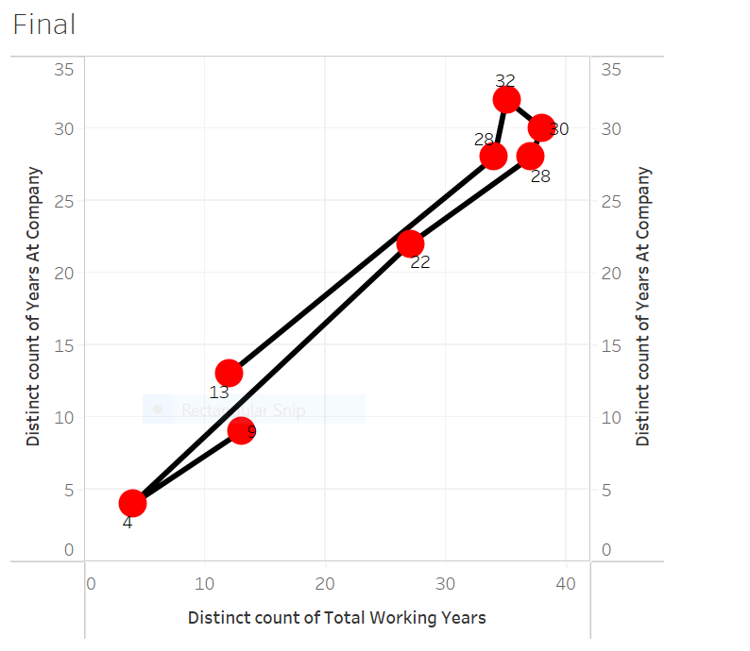
How many total years worked vs. Year worked at the company
Conclusion: However this is true in some cases but not all. Some employees have worked total hours within this company.
V2
Connected Scatter Plot in Tableau

Slide 8
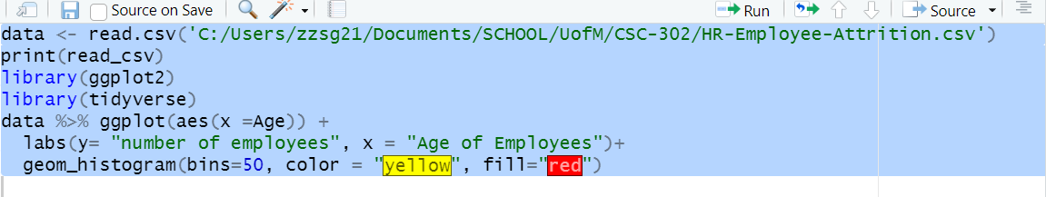
V3
CODE
What is the most populated age group
Prediction: Employees in their 30’s being the largest population
Histogram in R

Slide 9
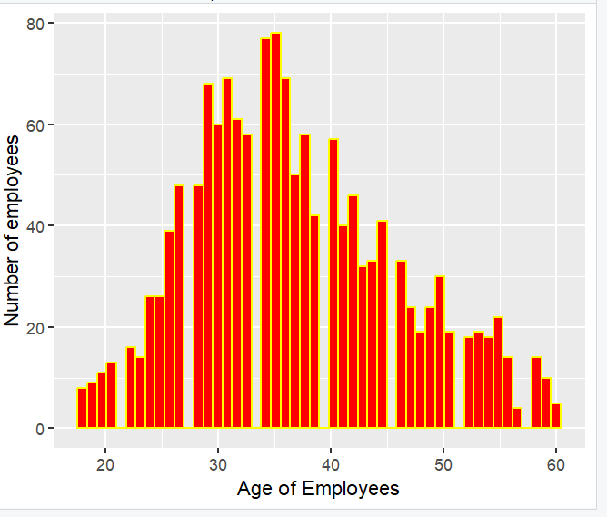
What is the most populated age group
V3
Conclusion: In fact the largest populated employee group are in their 30’s
Histogram in R

Slide 10
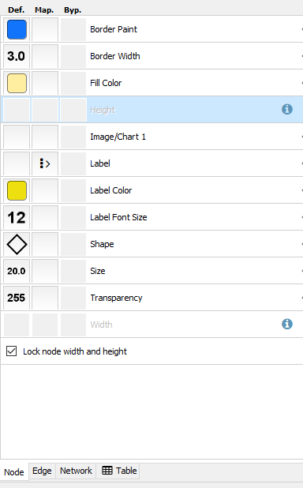
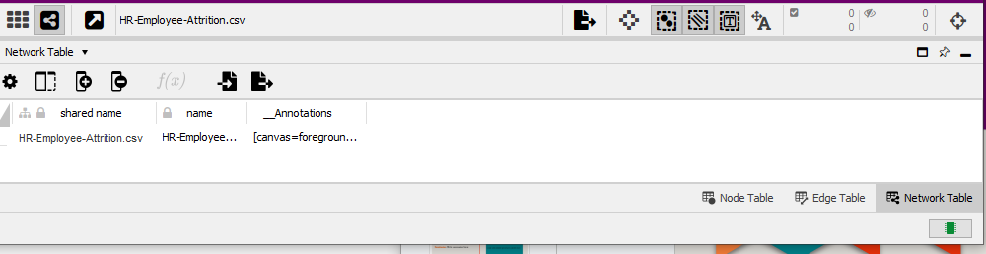
V4
CODE
How does miles to work apply to job satisfaction
Prediction: Further distance from work creates less job satisfaction
Cytoscape Network Chart

Slide 11
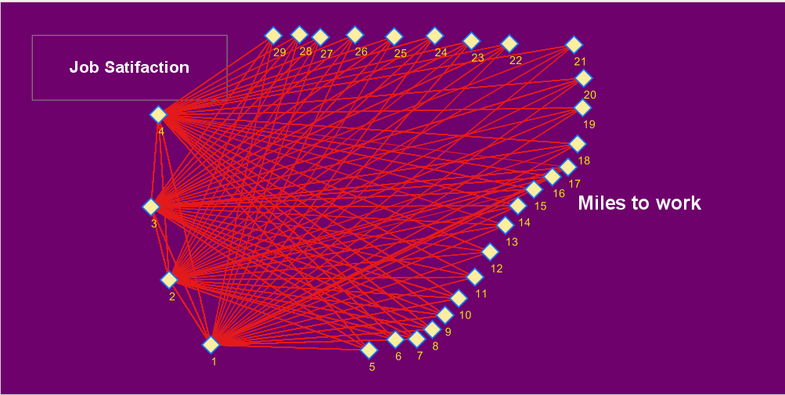
V4
How does miles to work apply to job satisfaction
Conclusion: Information showed that equal nature of satisfaction to distance from work is present.
Cytoscape Network Chart

Slide 12
V5
CODE
Does time with company and job satisfaction affect attrition?
Prediction: Most attrition will occur with the least satisfied and lowest tenured
Swarmplot using Seaborn within Python
sns.reset_orig()
sns.swarmplot(data=df, x='WorkLifeBalance', y='YearsAtCompany', hue='Attrition', )
plt.legend(loc=1)
plt.title("Employee Loss Factoring Work Life Balance and Experience")
plt.show()

Slide 13
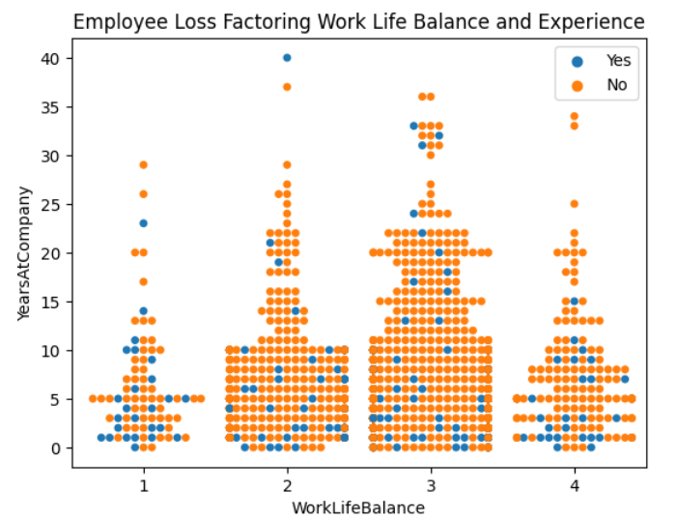
Does time with company and job satisfaction affect attrition?
V5
Conclusion: A majority of the attrition did occur within 5-6 years of hire. A surprisingly large number of employees with Good Work Life Balance left early in career.
Swarmplot using Seaborn within Python

Slide 14
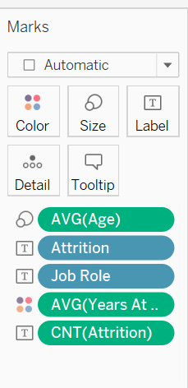
V6
CODE
Does time with company and job role affect attrition?
Prediction: Most employees lost will be early in their time with company
Tree Map created utilizing Tableau

Slide 15
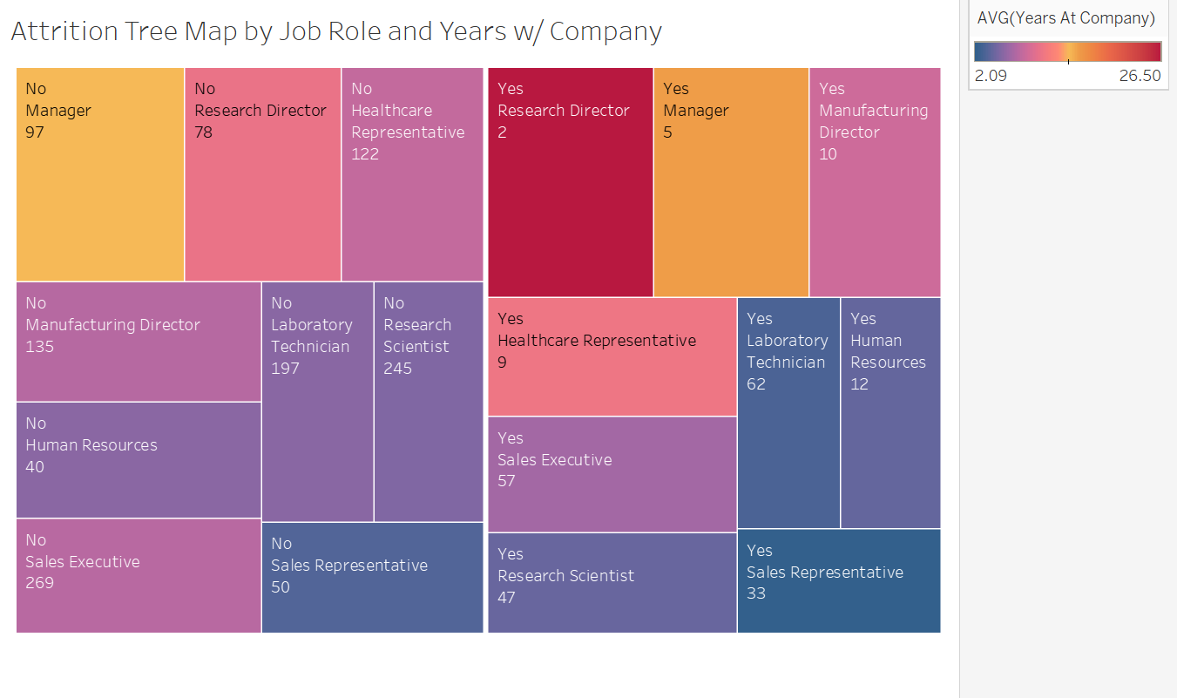
Does time with company and job role affect attrition?
V6
Conclusion: Time and job do play a role. Two of the highest lost groups are within 3 years of hire. Sales and lab technicians have high turnover rates
Tree Map created utilizing Tableau

Slide 16
V7
CODE
Does amount of time training affect salary increase?
Prediction: More training will provide for a larger increase in salary
Density Plot using Joyplot
%matplotlib inline
plt.figure()
plt.style.use('dark_background')
ax, fig = joyplot(
data =df[['TrainingTimesLastYear', 'YearsAtCompany', 'PercentSalaryHike']],
by = 'TrainingTimesLastYear', legend=True)
plt.title('Years with Company and Salary Increase by Time Training', fontsize=20, color='white', alpha=0.9)

Slide 17
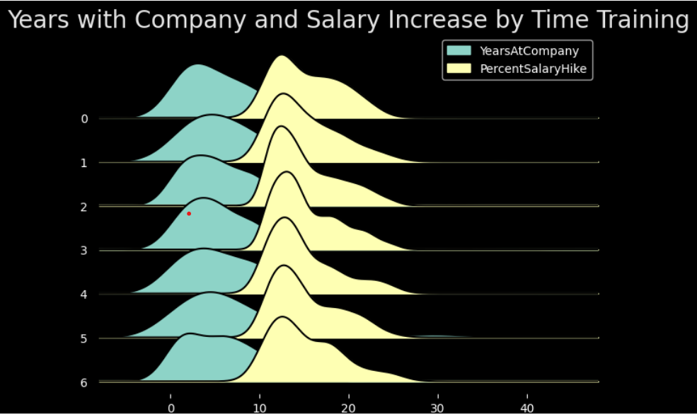
Does amount of time training affect salary increase?
V7
Conclusion: Training has little to no effect on salary increase
Density Plot using Joyplot

Slide 18
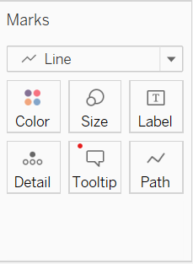
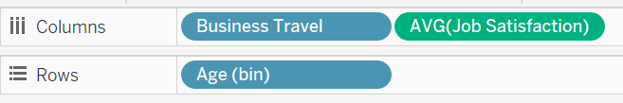
V8
CODE
Do travel and age affect job
satisfaction?
Prediction: As age increases, more travel will lead to less satisfaction
Line graph utilizing Tableau

Slide 19
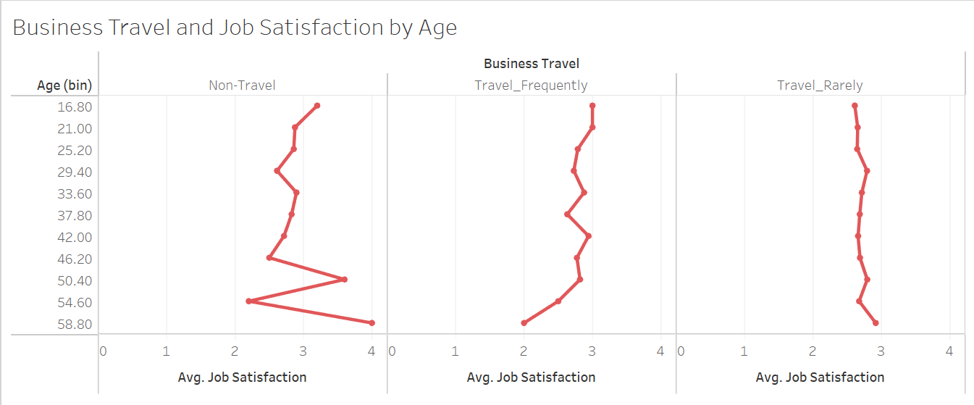
Does amount of travel affect job satisfaction?
V8
Conclusion: For those that frequently travel, there was a reduction in satisfaction for last 10 years. Interesting to compare to non-travelers for the same period.
Line graph utilizing Tableau

Slide 20
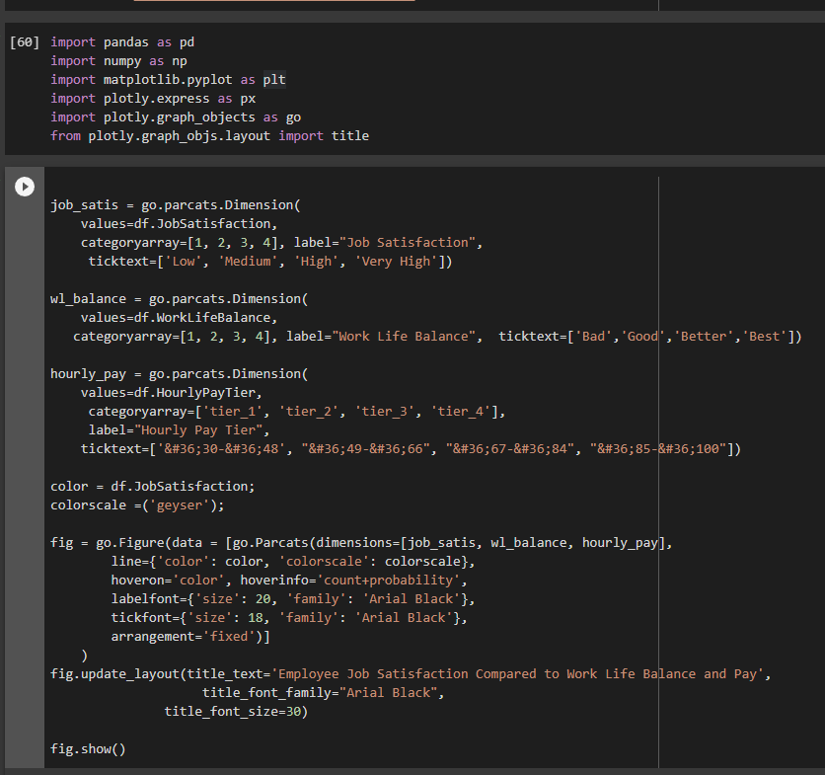
V9
CODE
How does work life balance and hourly pay rate affect employee Job Satisfaction?
Prediction: Higher pay will have the most influence over high job satisfaction.
Plotly Express Parallel Category Chart
Built on Python

Slide 21
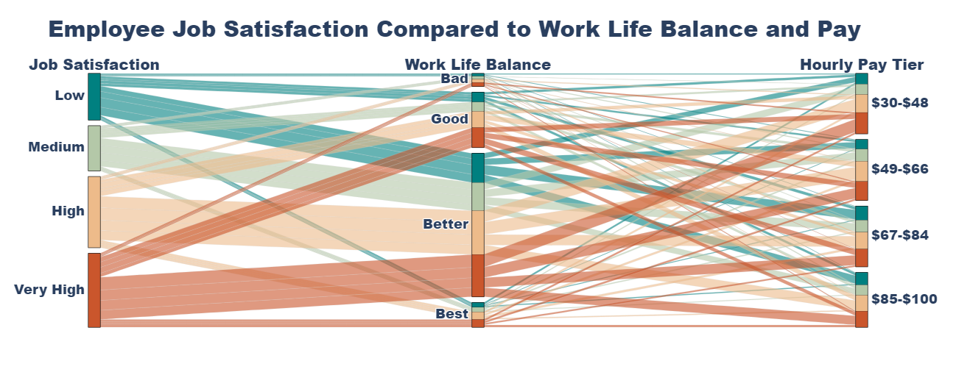
How does work life balance and hourly pay rate affect employee Job Satisfaction?
V9
Conclusion: Higher work life balance leads to higher Job Satisfaction overall. Pay does not influence Job Satisfaction.
Plotly Express Parallel Category Chart
Built on Python

Slide 22
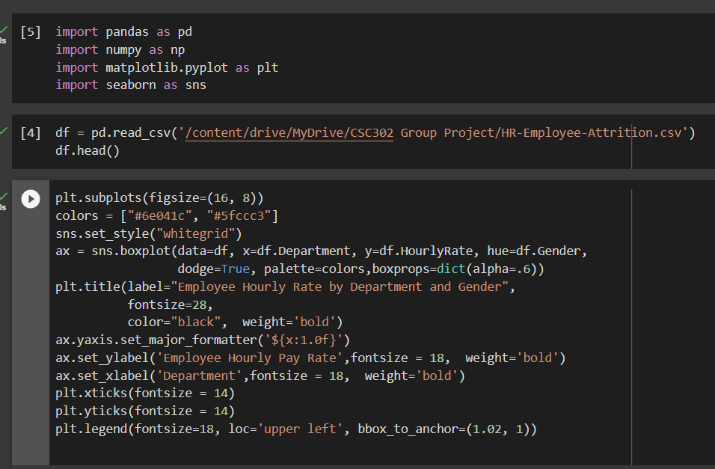
V10
CODE
How does employee hourly rate compare across departments by gender?
Prediction: Men get paid more on average than women in every department except HR.
Seaborn Boxplot Graph Built on Python

Slide 23
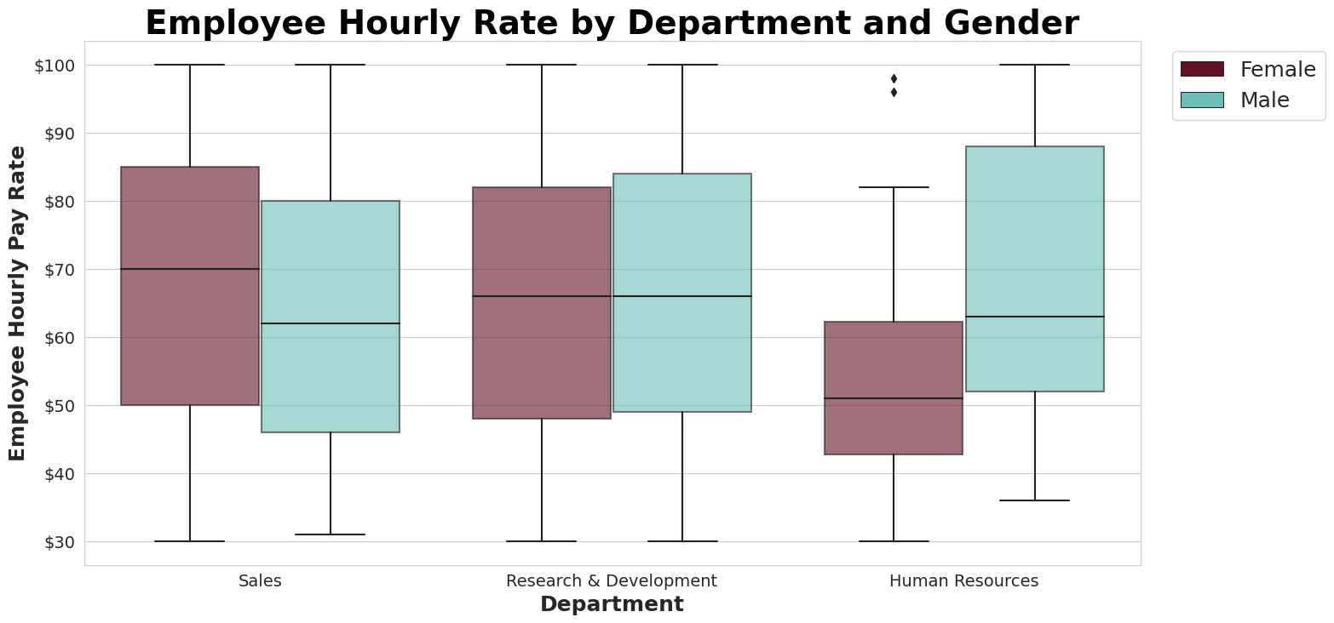
How does employee hourly rate compare across departments by gender?
V10
Conclusion: Women make more on average than Men in all departments except HR where Men make significantly more than Women.
Seaborn Boxplot Graph
Built on Python

Slide 24
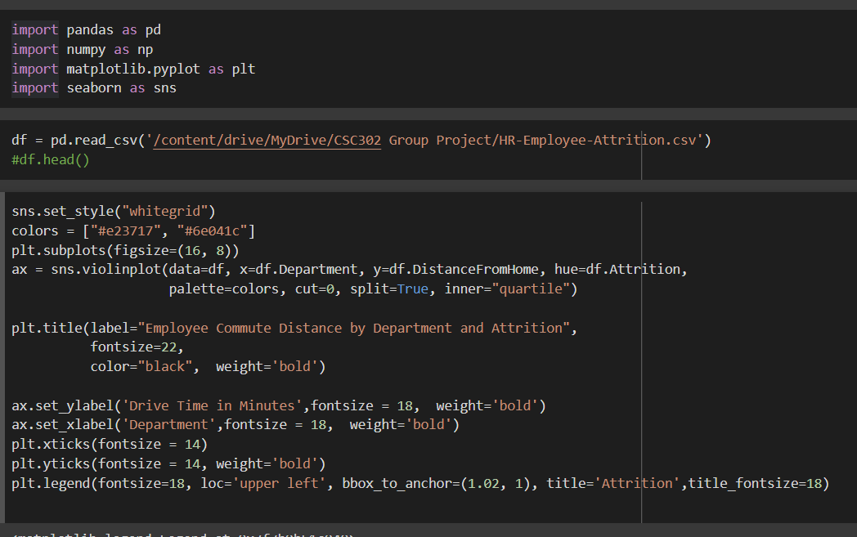
V11
CODE
How far do employees travel to work by department and how does it affect attrition?
Prediction: Employees do not commute far to work in all departments. Longer commutes increase attrition.
Seaborn Violin Plot Built on Python

Slide 25
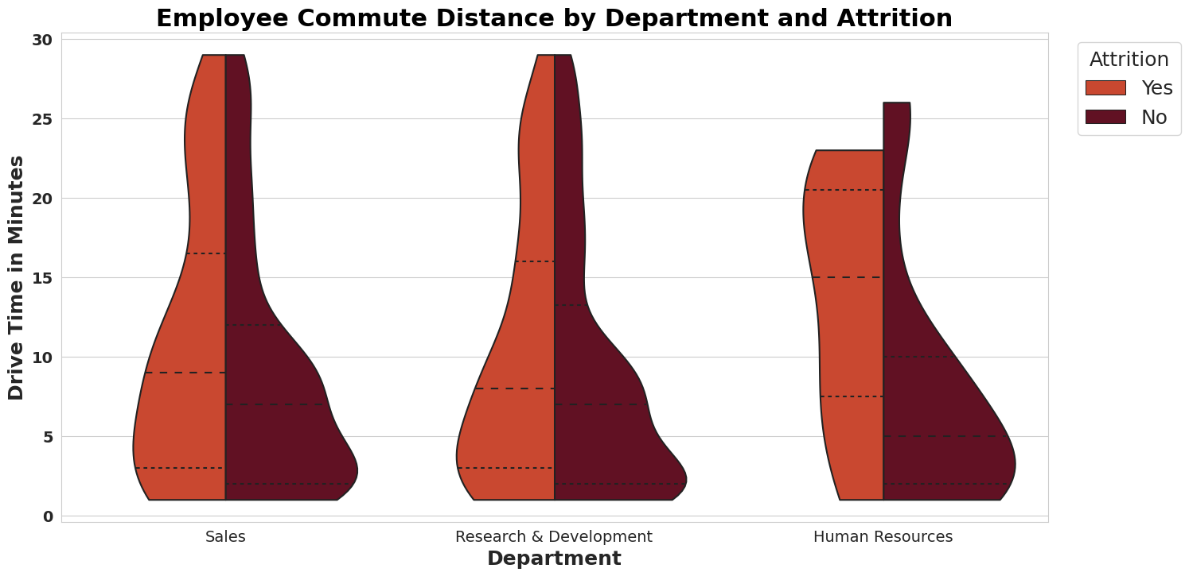
How far do employees travel to work by department and how does it affect attrition?
V11
Conclusion: HR employees generally commute farther than other departments. In all departments, employees no longer with the company did commute farther to the job.
Seaborn Violin Plot
Built on Python

Slide 26
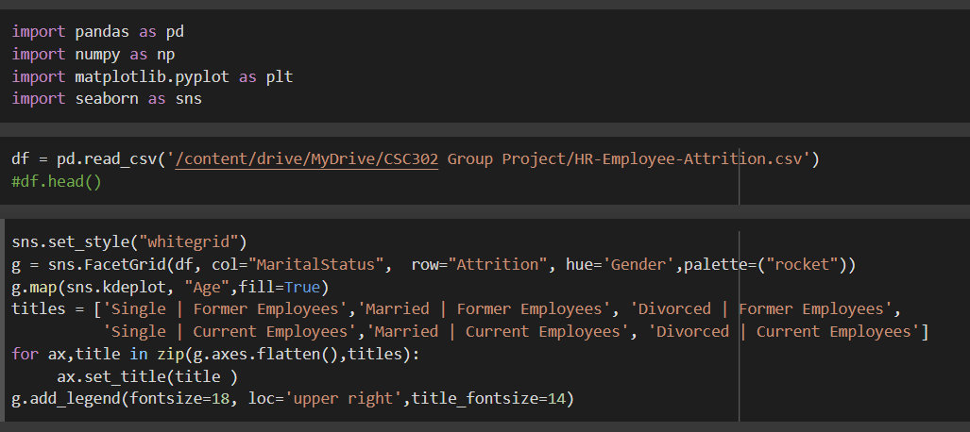
V12
CODE
How does marital status affect employee attrition by gender?
Prediction: Divorced employees have higher attrition rates across genders.
Seaborn Facetgrid Density Block Built on Python

Slide 27
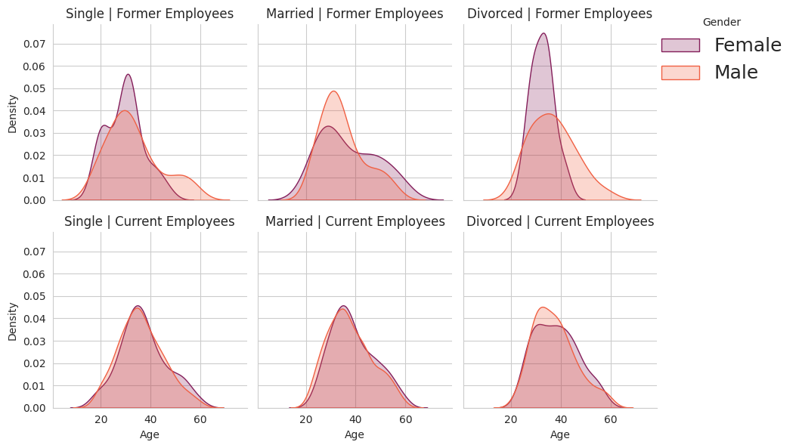
V12
How does marital status affect employee attrition by gender?
Conclusion: Divorced Female employees have higher attrition rates.
Seaborn Facetgrid Density Block
Built on Python

Slide 28
Conclusions
Single dataset was easier to work with but the volume of variables/columns made it harder to evaluate which were best for each graph
Predictions on this dataset were often wrong - we were surprised by the result in almost all visualizations
Dataset contained lots of numeric and categorical values, which helped in creating visualizations
Github Repository
https://github.com/katijumich/Final-Project-Group-1

Slide 29
Thank you!

